Slide 1
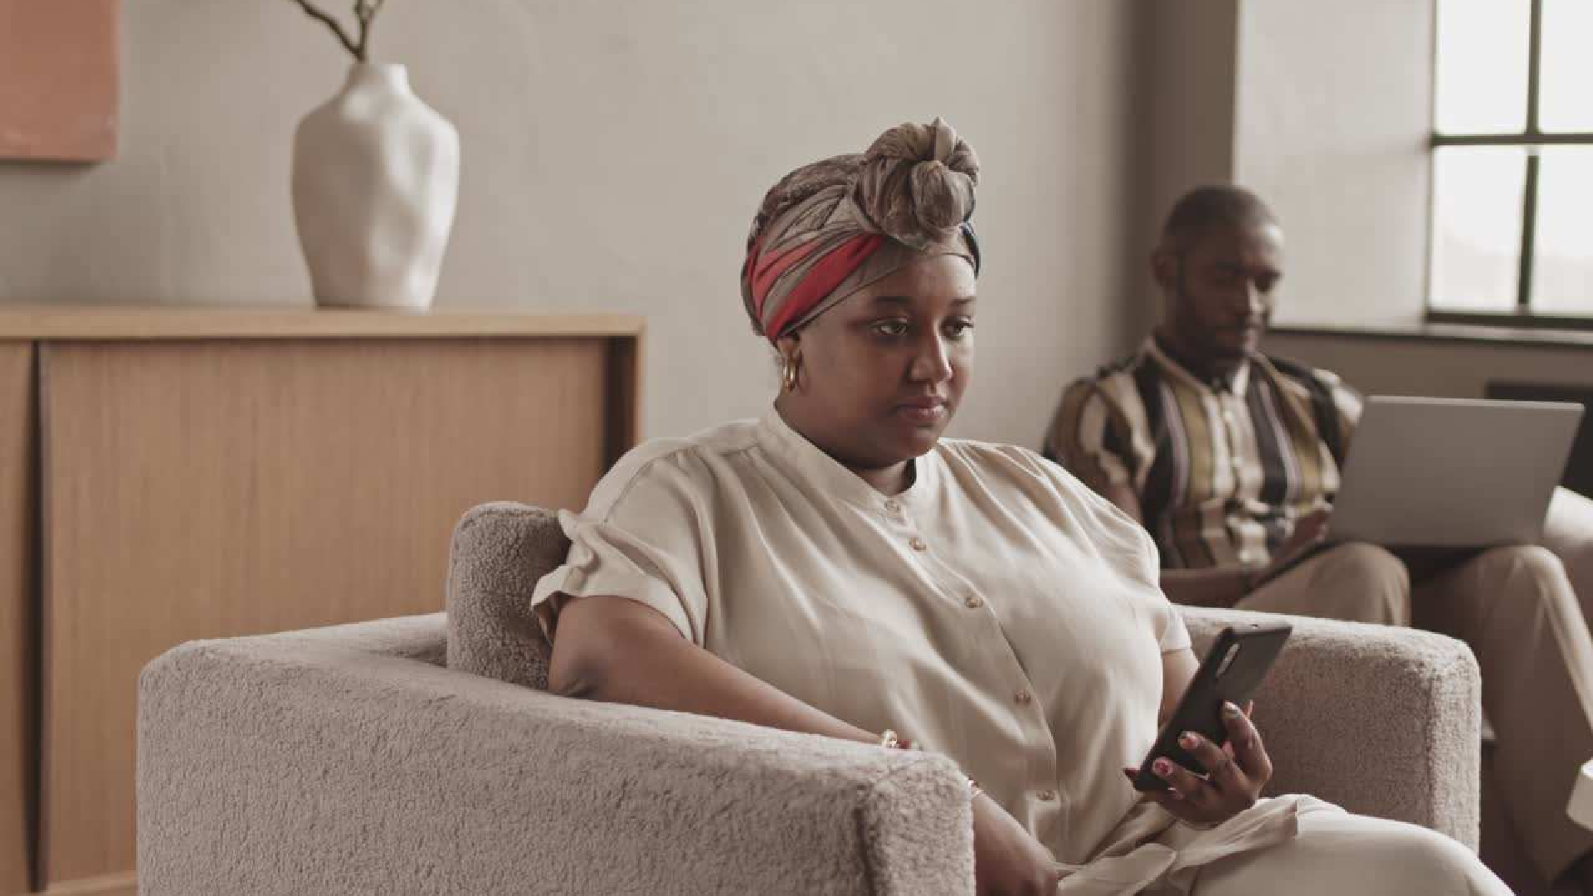
Philips Wireless Earbuds MARKET SURVEY
-Team 9-
Abhishek Rathi Adriano Vichi Anoushka Variava Francisca Ehidom Natan Kupczyk

Slide 2







INDEX
Problem / Opportunity Product Overview Market Trends Competitor Analysis Quantitative Data Qualitative Data
Key Insights
Business Recommendations

Slide 3

OUR MISSION
Our mission is to position Philips earphones in the UAE market by understanding how the product is perceived by consumers, who the competitors are, and how to increase sales in the UAE.

Slide 4
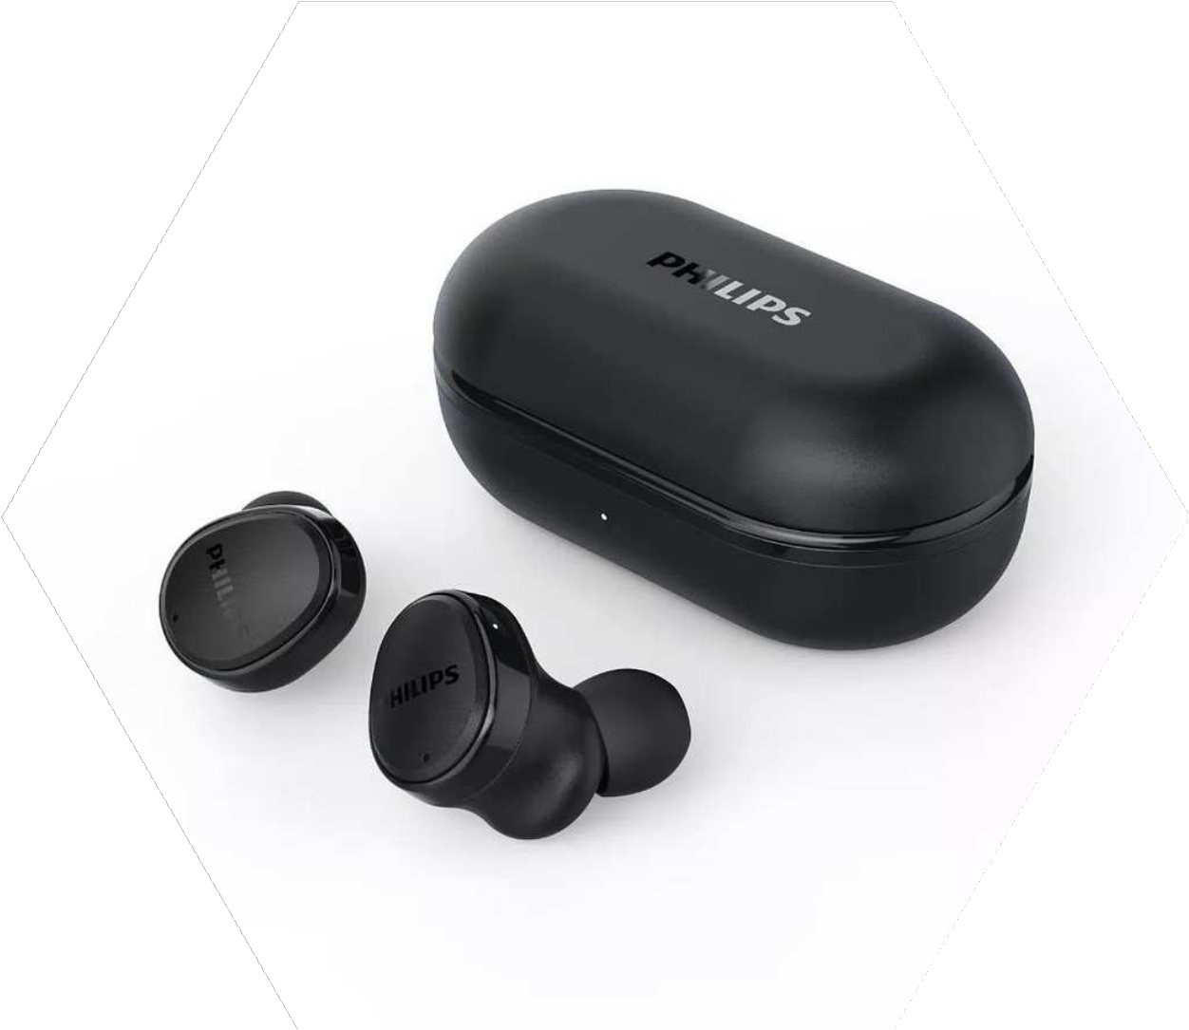




Product Overview
True Wireless Headphones TAT4556BK/97
9-20 hours talk time Bluetooth V5.2
47g weight
Water and Sweat resistant Available in black, pink and green
AED 360

Slide 5
Market trends
The trends found come from feedback after purchase on Amazon and Noon platforms
and from interviews conducted in Dubai Marina Mall and Mall of the Emirates
Earphones trends
Dubai Marina Mall & Mall of the Emirates
Amazon & Noon
Design / Look
Ease of use
Battery life
Size
Comfort in the ear
Wireless charging
Microphone quality
Sound quality
Active noise cancellation
Voice call quality

Slide 6
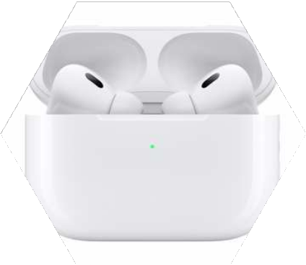
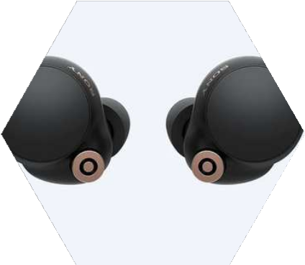
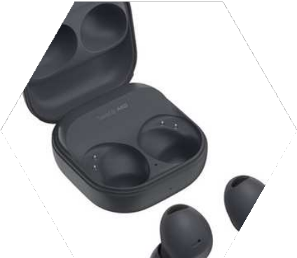
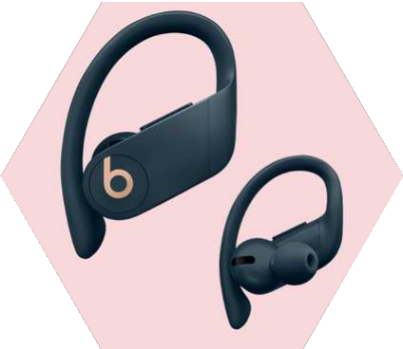
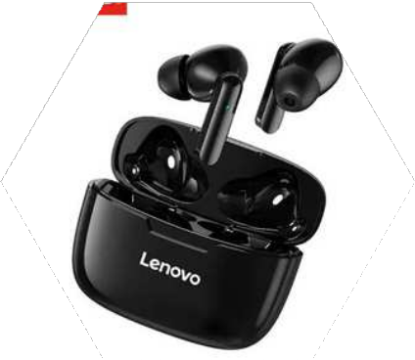
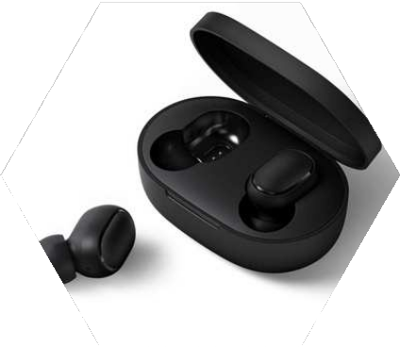
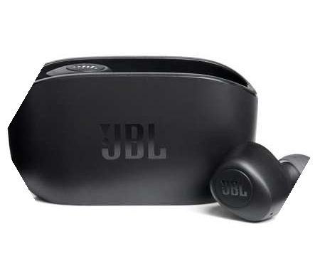
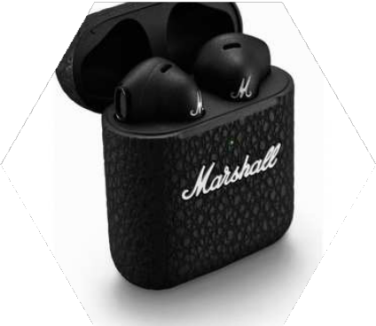
Competitor analysis of Philips earbuds
Apple Sony
Samsung Beats by Dr. Dre
Lenovo
Xiaomi
JBL
Marshall

Slide 7
Competitor Analysis of similar products
Philips
Apple
Sony
Samsung
Beats by Dr. Dre
Marshall
Model
True Wireless TAT4556BK/97
AirPods Pro
WF-1000XM4
Galaxy Buds2 Pro
PowwerBeats Pro
Motif True
Price
360 AED
950 AED
700 AED
730 AED
730 AED
730 AED
Bluethooth
V5.2
V5.3
V5.2
V5.3
V5.3
V5.3
Battery life
9-20h
6-30h
8-16h
7.5-30h
9-24h
4.5-20h
Active noise cancellation
YES
YES
YES
YES
YES
YES
Weight
47g
50.8g
40g
10g
20g
9g
Colour
Black, Green, Pink
White
Silver /Black
Graphite / Borapurple/ White
Black / Ivory / Navy
Black

Slide 8
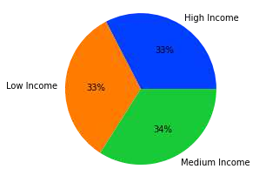
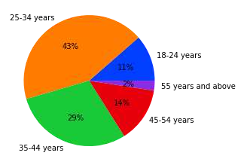
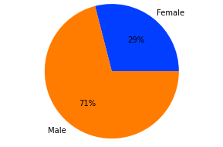
Region - UAE [Source: Statista]
Income - Earphone users
Age demographics - Earphone users
Gender - Earphone users

Slide 9
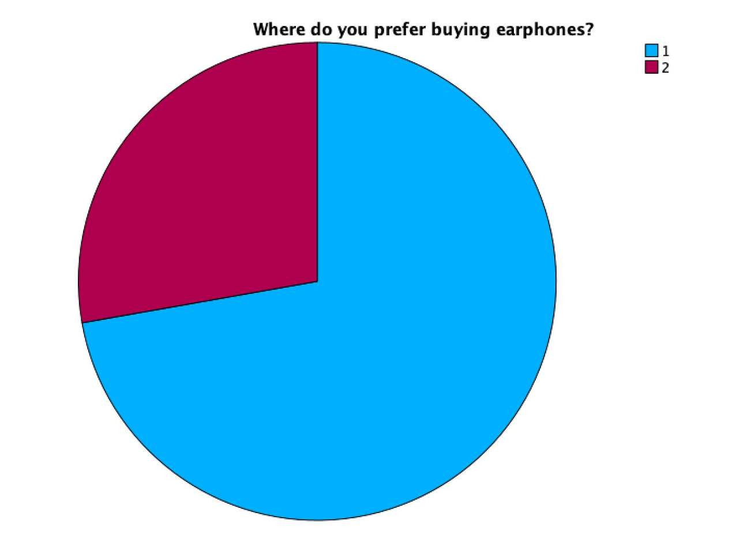
WHERE DO YOU PREFER BUYING EARPHONES?
1- Physical Stores (73%)
2 - Online Stores (27%) Amazon or Noon

Slide 10
Active Noise Cancellation
Analysis of the most popular features in earbuds
Descriptive Analysis
Battery life
Easy setup / Bluetooth pairing Voice call quality
Ear comfort Sound quality

Slide 11
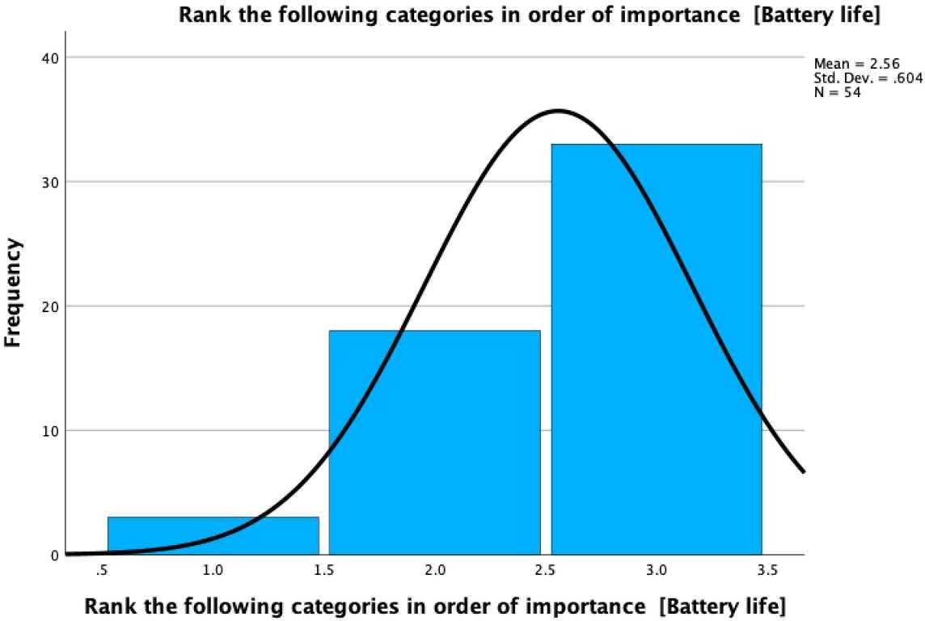
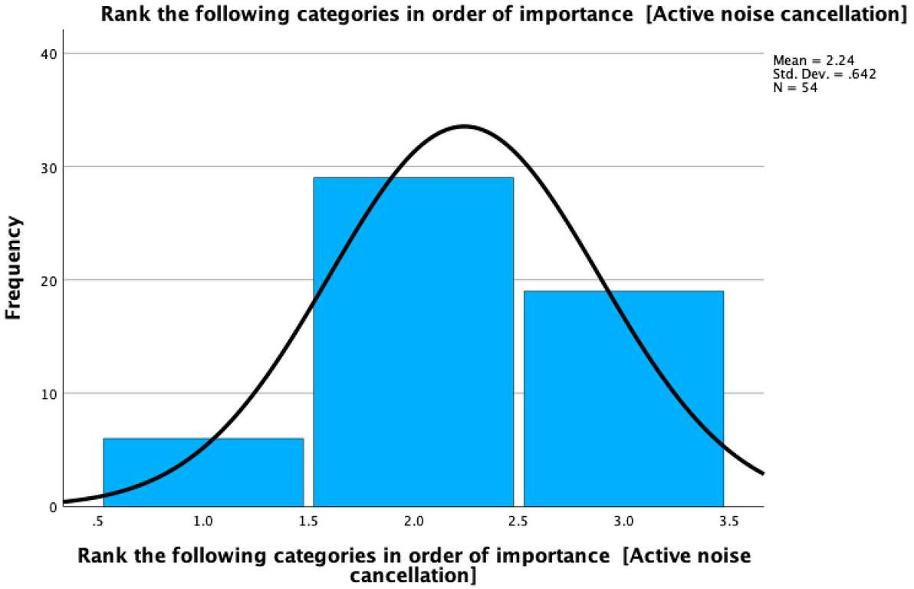
IMPORTANCE OF "ACTIVE NOISE CANCELLATION"
IMPORTANCE OF "BATTERY LIFE"

Slide 12
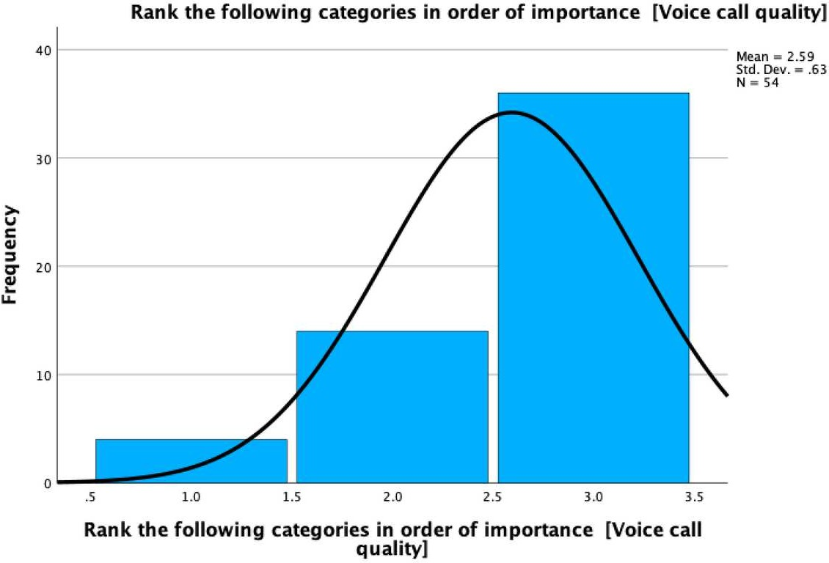
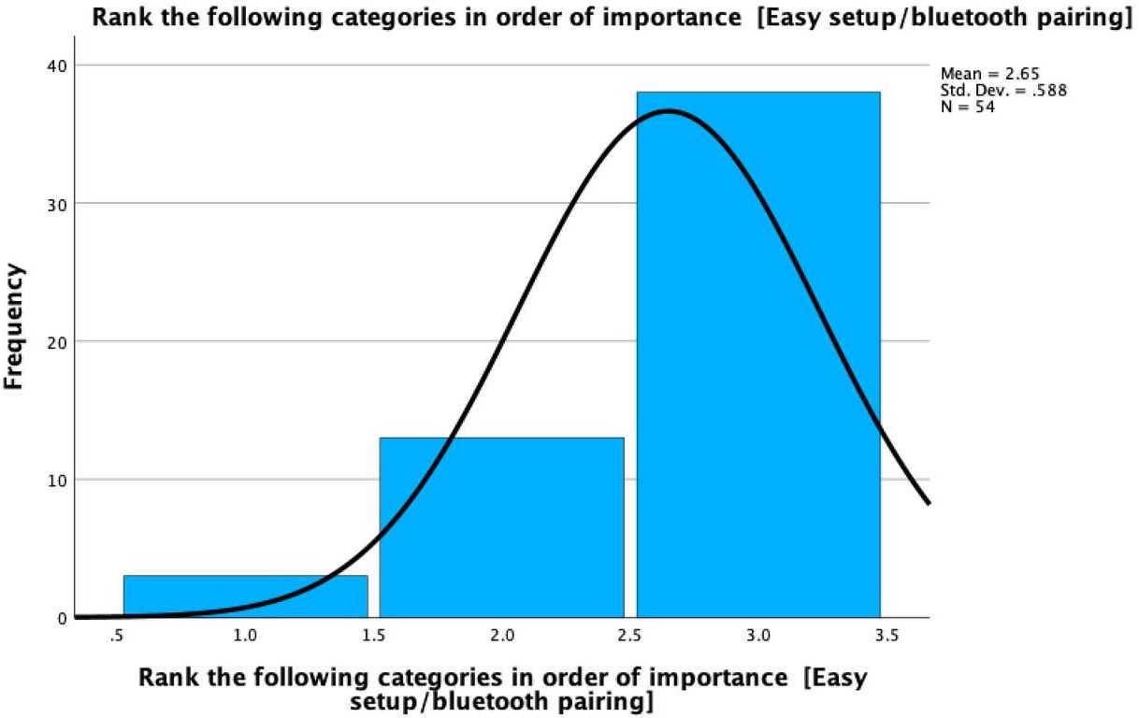
IMPORTANCE OF "EASY SETUP/BLUETOOTH PAIRING"
IMPORTANCE OF "VOICE CALL QUALITY"

Slide 13
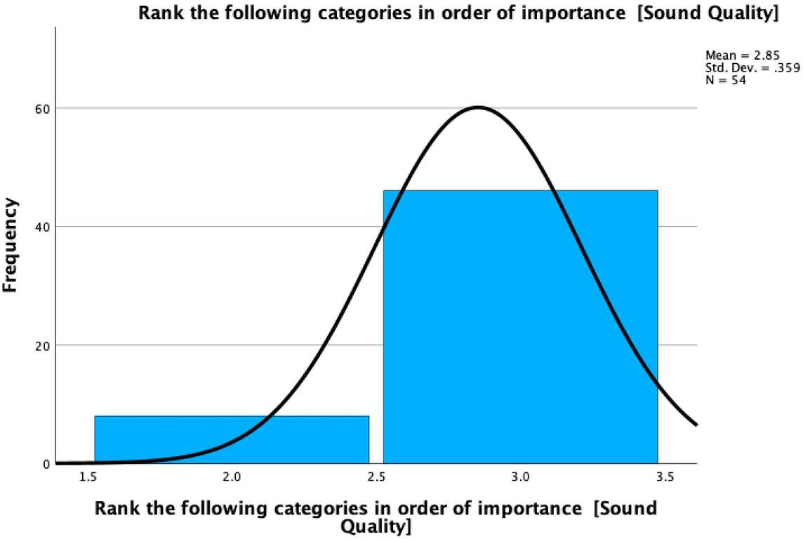
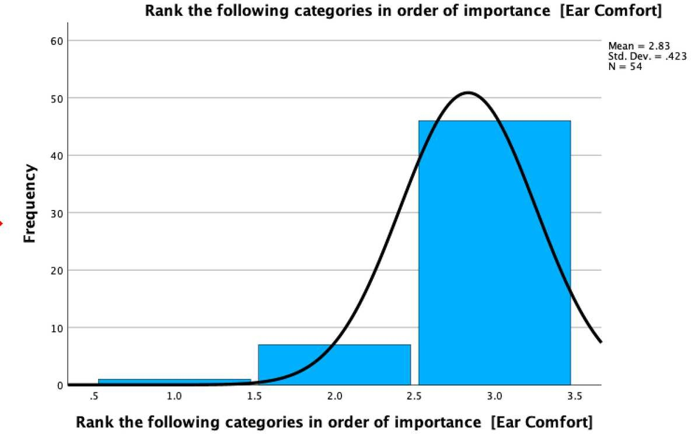
IMPORTANCE OF "EAR COMFORT"
IMPORTANCE OF "SOUND QUALITY"

Slide 14
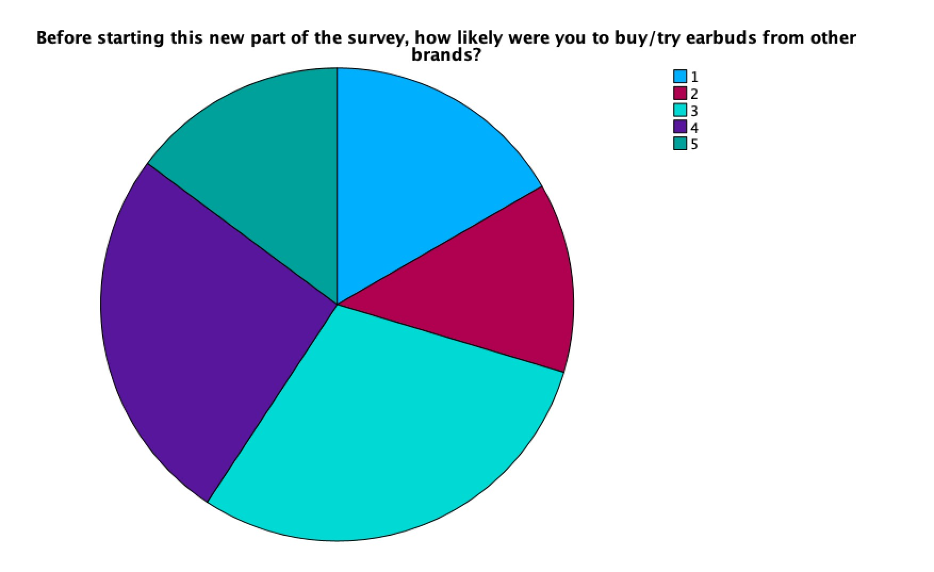
5 - Very likely 14.8%
1- Very Unlikely
16.7%
4 - Likely
25.9%
2 - Unlikely
13%
3- Neutral
29%

Slide 15
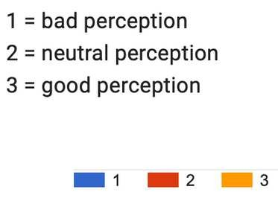
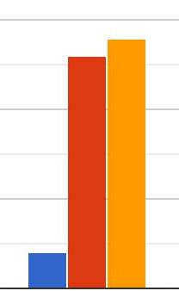
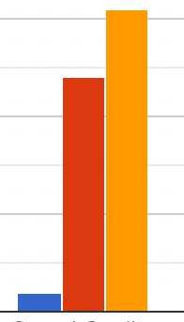
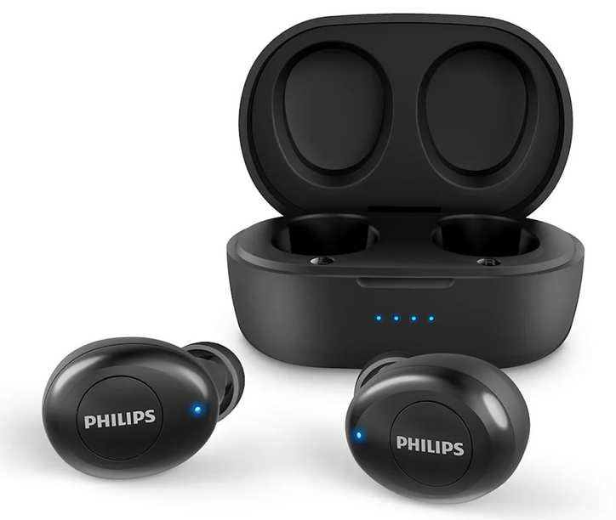
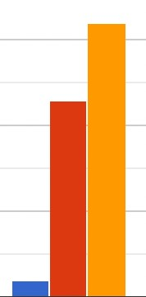
Just by looking at this picture, consumers have these perceptions about the product:
Ear Comfort
Sound Quality
Battery Life

Slide 16
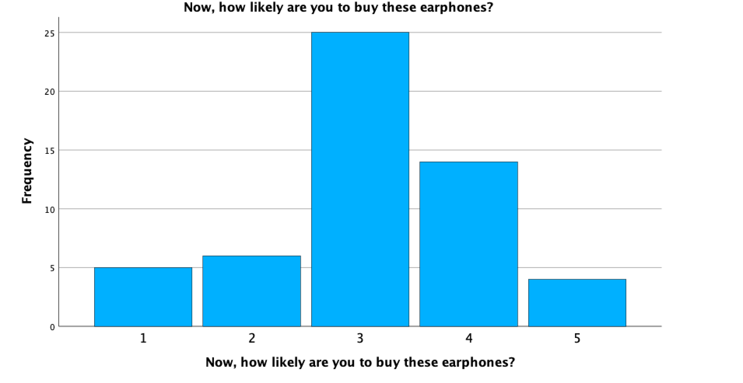
Philips Earphones
Very Unlikely
Unlikely
Neutral
Likely
Very likely

Slide 17
QUALITATIVE DATA
"I have an iPhone; not sure how seamless the Bluetooth pairing will be with other products."
"Would have to try the Philips product in real life in order to decide."
"I never knew that Philips had earphones before this survey."

Slide 18
Likelihood of people buying Philips earbuds based on their perception about:
Ear Comfort Sound quality Battery life
Active Noise Cancelling
Design
Water/Sweat Resistance
Brand
Product reviews Price
Wireless Charging
Voice call quality
Easy Setup / Bluetooth pairing
Correlation & Regression

Slide 19
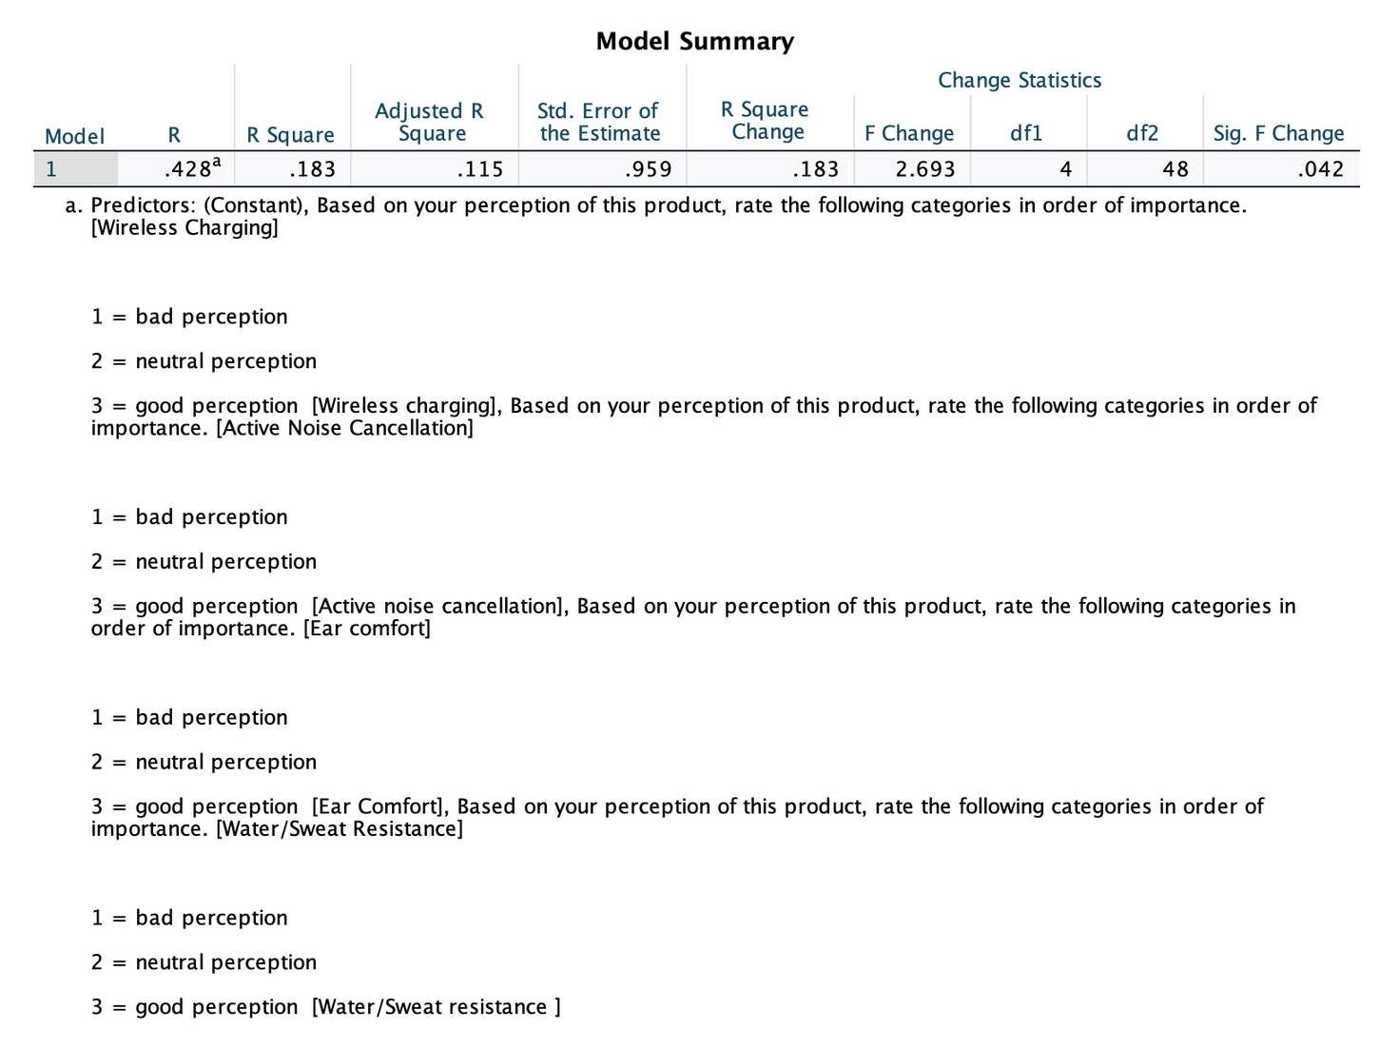
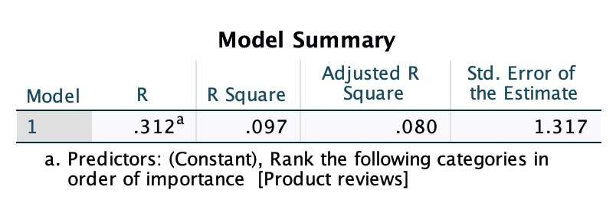
Correlation & Regression - Key Insights:
R Square ~ 1O%
R Square ~ 18%

Slide 20

WHAT PHILIPS NEEDS TO DO TO GET A NEW PRODUCT INTO THE EMIRATI MARKET
OUR STRATEGY IS BASED ON DATA COLLECTED THROUGH INTERVIEWS AND SURVEYS

Slide 21
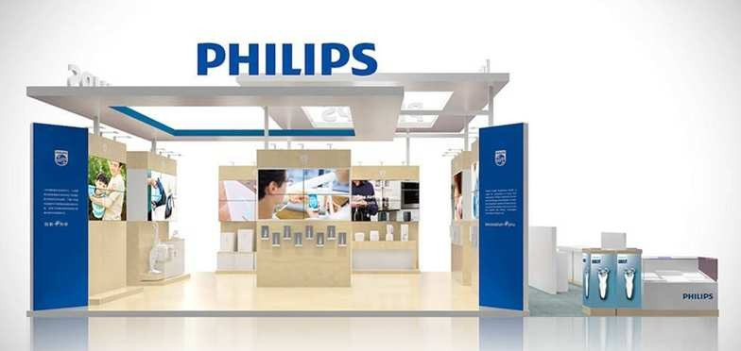
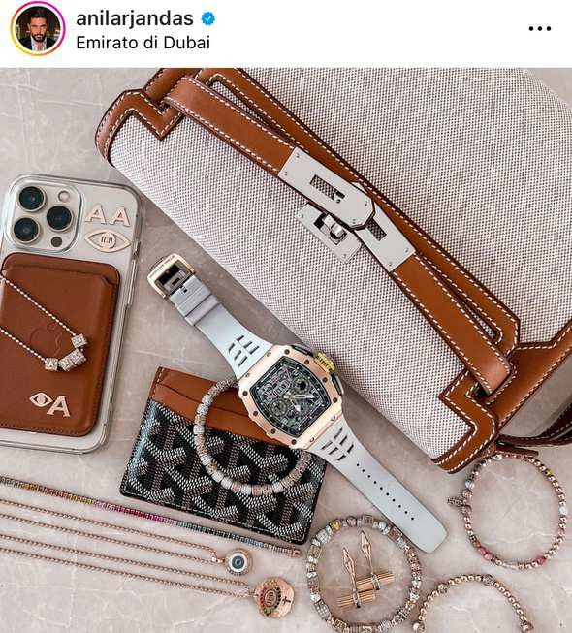
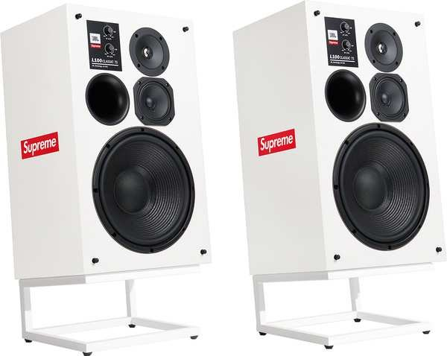
Strategy
POP-UP STORE/ FLASH RETAIL
SOCIAL MEDIA & INFLUENCER MARKETING
PARTNERSHIP WITH OTHER BRANDS

Slide 22


PRODUCT RECOMMENDATIONS & OUR MESSAGE
Based on the data collected, we can say that Philips needs to invest in marketing in the UAE if it wants to increase sales and the user base that uses its product.
The target audience of people who might like the product is as follows: Average age 18 - 34
Corporate employees, students, lecturers, entrepreneurs Dissatisfied users of current earbuds
"Dedicate yourself to a niche: Stop Wanting to be Everything to Everyone." Andrew Davis

Slide 23
Thank
you!

